Slide 1

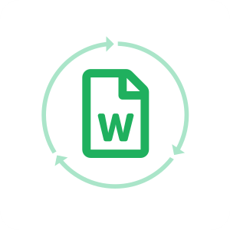
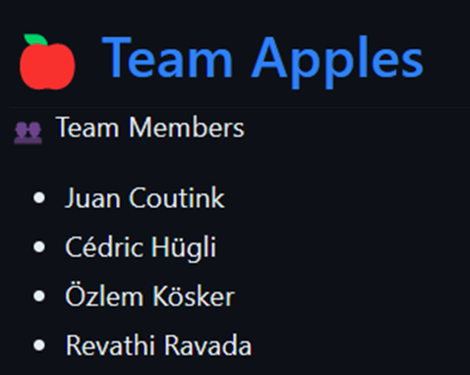
Customer Service Chatbot

Slide 2
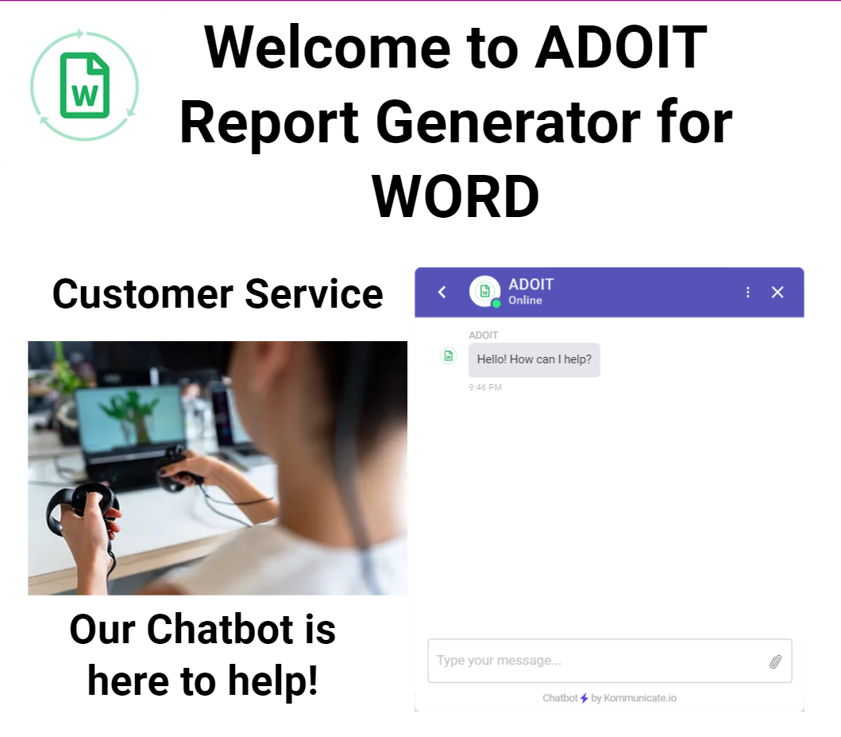
Customer Service Chatbot
The Chatbot helps to solve any potential problem the customers may face throughout the sales cycle using an interactive frontend website.
Demonstration video: https://tinyurl.com/w4u9e6yy

Slide 3
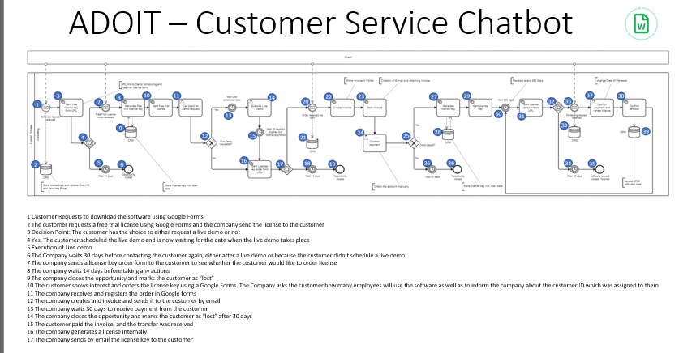
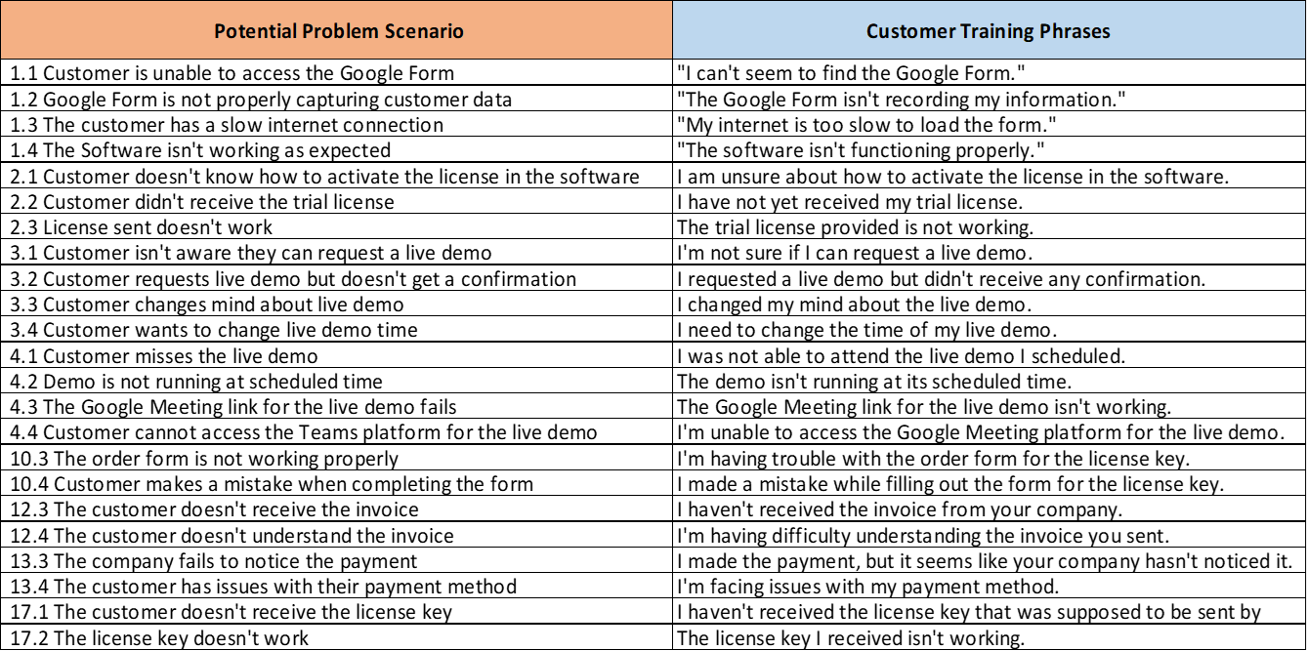
What is solves
Issues such as:
Accessing ordering forms for our software license: trial, purchase and renewal
Difficulties to use the software
Licenses were not sent to the customer/ didn’t receive/lost them
The customer needs to talk chat/video call with us
The customer doesn’t receive/understand our invoices
Solutions were mapped all along sales cycle to ensure the customer always gets an answer. More than 17 different type of problems were identified with at least 4 different inputs from the customer.

Slide 4
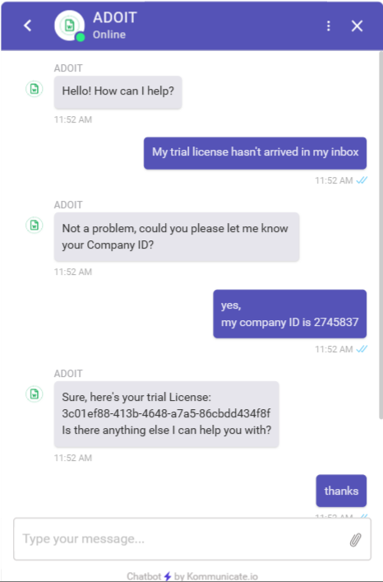
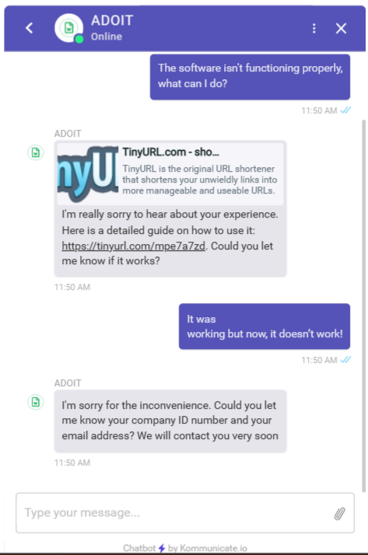
Examples:

Slide 5




How we did it
Tools:
Frontend using WIX.com website and HTML code to add Kommunicate.io as a widget
Chatbot Interface using Kommunicate.io
Webhooks using Make.com to Fill Google sheets, search rows and use Reponse fulfillment
Chatbot natural language understanding platform using Google Dialogflow
Automations:
Provides user Manual to Customer - integrated link
Records Company ID and email in Google Sheets for Customer Service get in contact with client
In case the customer urgently needs assistance, it automatically handsover the conversation to a live agent using Kommunicate.io.
Provides customer's trial license in case they didnt get it, using search rows and response fulfillment
Provides an appointment scheduler using Google Calendar in case customer needs to reschedule or missed the live demo - integrated link
Notes:
How to Add Chatbot with Wix Website in 8 Easy Step (kommunicate.io)

Slide 6
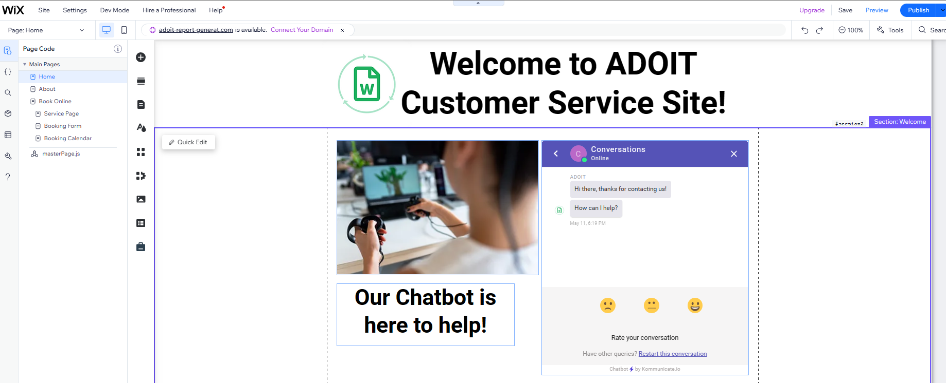
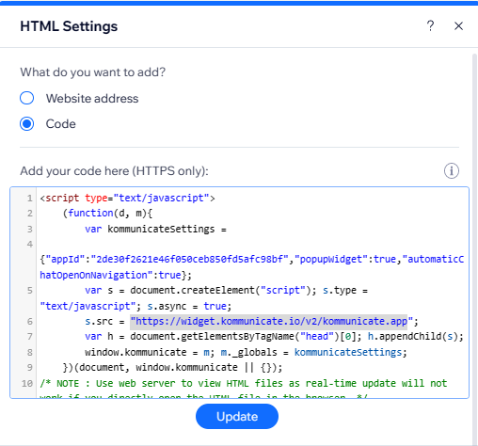
How we did it: WIX.com

Slide 7
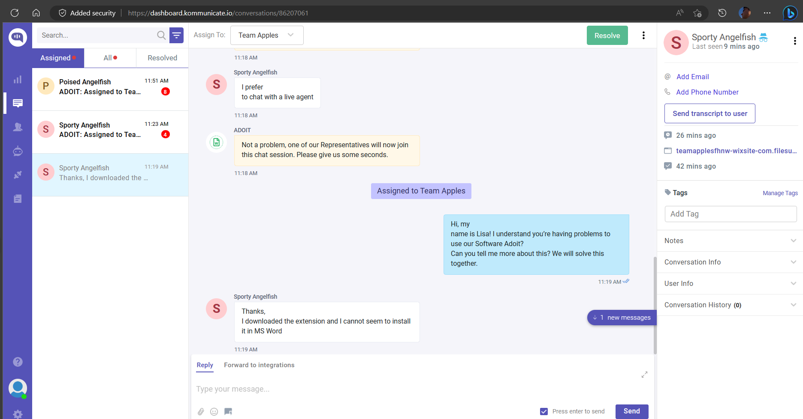
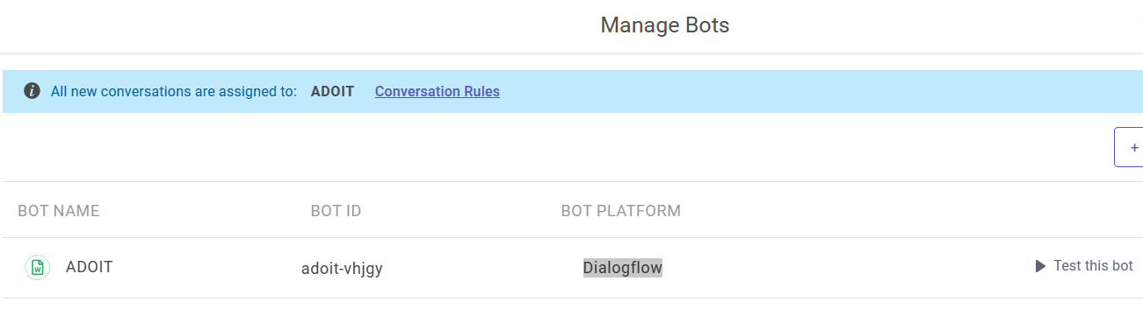
How we did it: Kommunicate.io

Slide 8
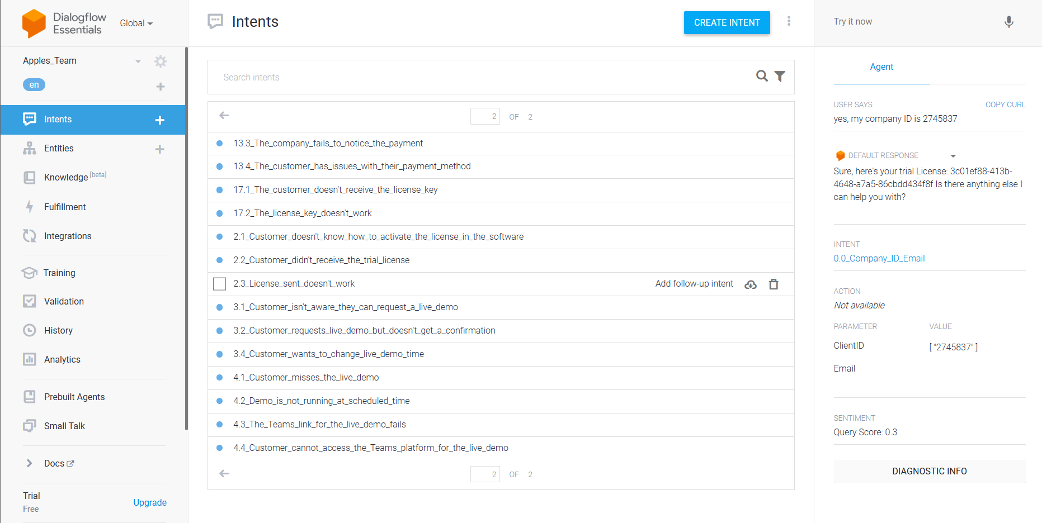
How we did it: Dialogflow

Slide 9
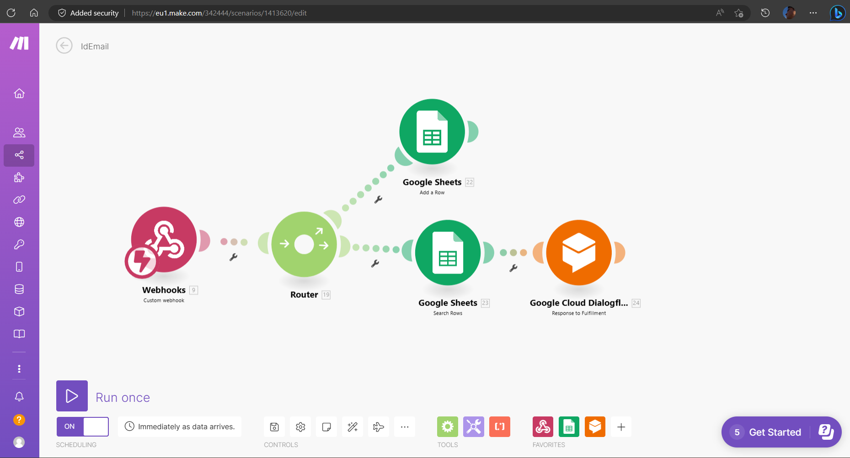
How we did it: make.com

Slide 10
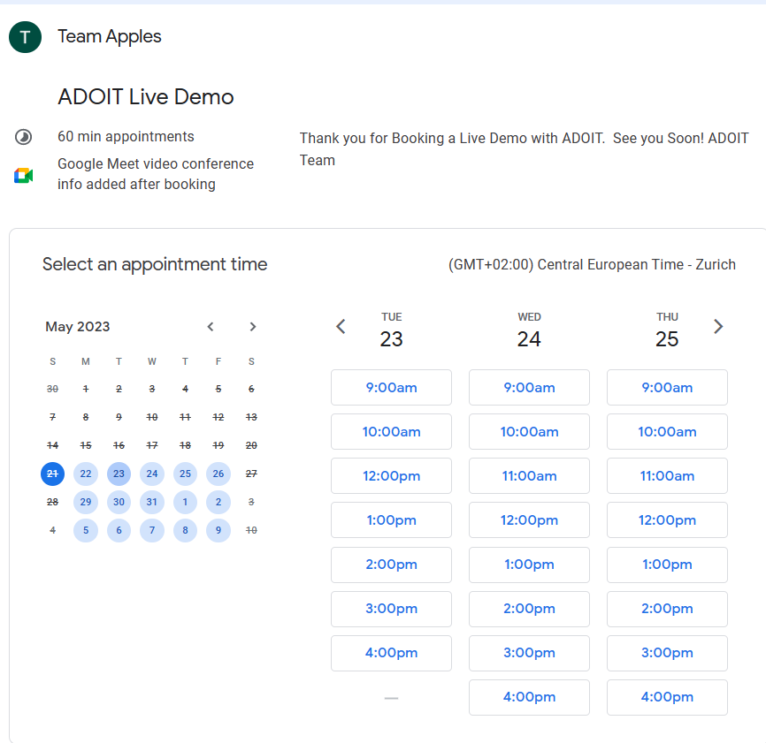
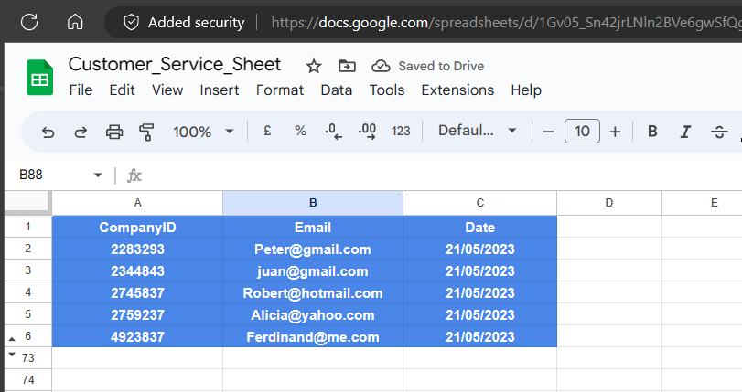
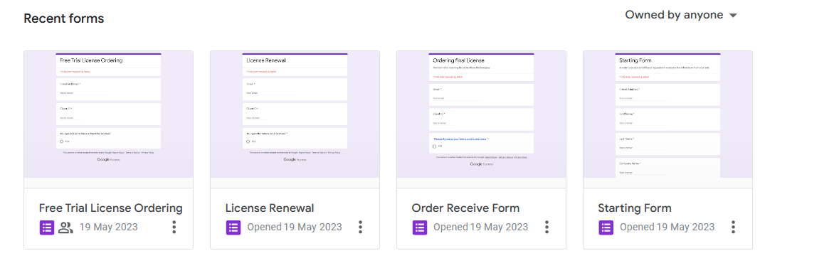
How we did it: Google Calendar, Forms, Sheets

Slide 11
ADOIT Customer Service Chatbot

